Slide 1
Steps to finish the Practice for World Cup program

Slide 2
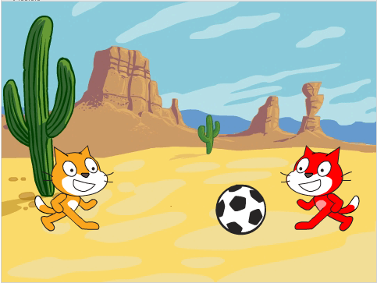
The Practice for World Cup program
In this program, two Sprites gather together to practice soccer. And yes, we need at least two Sprites to practice together. The soccer ball is passed between the two Sprites. When the ball reaches a Sprite, the Sprite will give realistic movement to imitate kicking the ball back to the other Sprite. As the Sprite will hold the ball for a little while, it is not good to just use the until-touching techniques.
Stage
A dessert scene is chosen for fun. I guess you can practice soccer in the bedroom, in the kitchen, and in many other places.

Slide 3
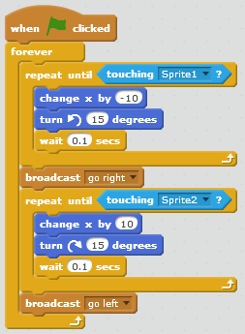
The Practice for World Cup program
Ball
Find and add the Ball-Soccer sprite.
You may choose an interesting backdrop where the Sprites can play soccer.
Place the ball in the middle of the field.
Gather the below blocks.

Slide 4
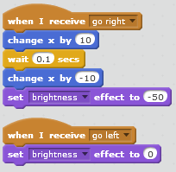
The Practice for World Cup program
Sprites
We need two Sprites to practice together. In our demonstration, we colored the Sprites for easy identification
Place one on the left of the stage, and one on the right. They should be on almost the same horizontal line of the Ball.
Change their direction to make them both face the Ball.
Gather the below blocks for Sprite1, which is on the left. Gather similar blocks and make adjustment for Sprite2 which is on the right.
The Sprite who is not having its turn to kick will be dimmed with the set-brightness-effect block.

